Slide 1

The ARM Architecture

Slide 2
Agenda
ARM Introduction
Architecture Extensions
ARM7TDMI-S
Processor Modes
Registers
ARM Vs Thumb
Instruction Set
System Design
Summary

Slide 3
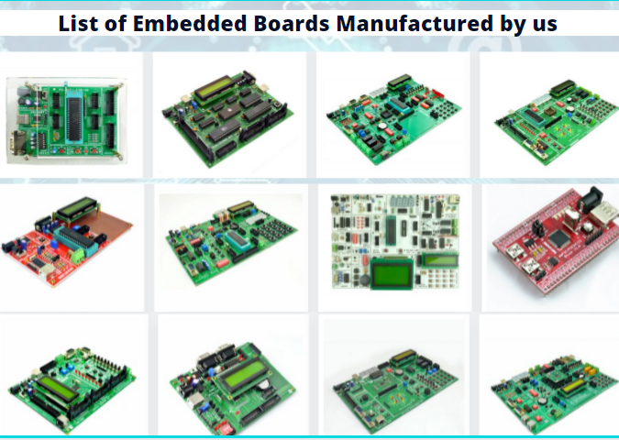
About Pantech
Started in the Year 2004
Lab equipments and Sensor Interface
Manufacturer of Brainsense EEG Headset
Reconfigurable Algorithms on AI
Manufacture of AI development Boards
Power electronics, Fuel cell and Renewable Energy trainers
www.pantechsolutions.net

Slide 4


About me
My Primary Expertise
Microcontroller Architecture: 8051,PIC,AVR,ARM,MSP430,PSOC3 DSP Architecture: Blackfin,C2000,C6000,21065L Sharc FPGA: Spartan,Virtex,Cyclone Image Processing Algorithms: Image/Scene Recognition, Machine Learning, Computer Vision, Deep Learning, Pattern Recognition, Object Classification ,Image Retrieval, Image enhancement and denoising. Neural Networks : SVM,RBF,BPN Cryptography :RSA,DES,3DES,Ellipti curve,Blowfish,Diffe Hellman Compilers: Keil,Visual DSP++,CCS, Xilinx Platform studio,ISE, Matlab, Open CV
https://www.linkedin.com/in/jeevarajan/
www.pantechsolutions.net

Slide 5
Announcement
Attendance Link at 9 pm
Minimum attendance required for an E-Certificate is 27 Days. Attendance link will be valid for 1 hrs. after the event.
For Internship Candidates no attendance required ,it will be accessed from the LMS Portal. (learn.pantechsolutions.net)
Recorded Video Streaming for LAB classes to improve Learning Experience
8051 – 5 Days workshop –use the same attendance form
support.pantechsolutions.net

Slide 6


What you get on 30 Days Internship

Slide 7
Mindset Lesson for the Day
“Formal Education will bring you living, Self education will bring your fortune”.-Jim rohn
“ Learn ,Unlearn, Relearn”
The power of repetition
“ Program your subconscious mind for success”

Slide 8
ARM Ltd.,
Founded in 1990
Spin out of Acorn Computers
Designs the ARM range of RISC processor
Licenses ARM core for Design Partners
ARM does not fabricate Silicon on own
VLSI Technology becomes an investor and the first licensee
Develops technology to assist with ARM Arch.
Software Tools
Boards | Debug Hardware | Peripherals
Application Software | Bus Architecture
Notes:
designs to semiconductor partners who fabricate and sell to their customers.

Slide 9
IP – Intellectual Property
ARM provides hard and soft views to licensees
RTL and Synthesis Overflow
GDSII Layout
Licensees have the right to use hard or soft views of the IP
Soft views include gate level net-list
Hard view are DSMs
OEMs must use Hard Views
To protect ARM IP
Notes:
1.Graphic Data Source – IC Fabrication File Formats
-Files normally stored in magnetic strip
-IC Layout Artwork files
2.

Slide 10
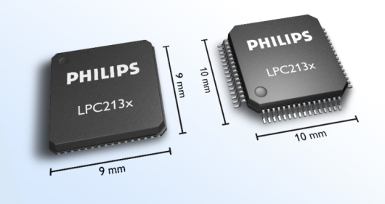

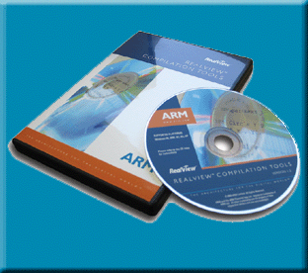
ARM Overview
Silicon Manufacturer
NXP | Atmel | SAMSUNG | INTEL
IP Core
RTL / GDSII Layout
Development Tools
IDE/Debugger
ICE
IAR
KEIL
Realview…

Slide 11
ARM Overview
Over 200 processor licensees
2500 individual company users of ARM physical IP
50,000 users of ARM development tools
ARM has highly adaptable business models with a range of entry points for all potential customers.

Slide 12
Markets
The FIVE key markets are:
Embedded Solutions
Smart Cards
Enterprise Solutions
Flash Cards
Printers
Home Solutions
Still Cameras
Digital TV
Automotive
Dashboard Controls
Hard Disks
Set Top Box
Mobile Solutions
Bluetooth
PDA
Smart Phone
Emerging Applications
Gaming
Robot
And much more….
90 % of the mobile handsets use ARM Technology

Slide 13
Processor Licensee
ARM licenses its microprocessor IP to majority of the semiconductor companies.
Family | Licenses
CortexTM | 69*
ARM11TM | 72
ARM9TM | 253
ARM7TM | 171
Statics info 04/12/2009 – ARM website

Slide 14
Why ARM ?
Built in architecture extensions
THUMB®2 - Greatly improved code density
DSP - Signal process directly in the RISC core
Jazelle® - Java acceleration
Trustzone™ - Maximum Security Environment
Core Performance
- Running from 1MHz to 1 GHz with architectural performance enhancements for media and Java.
Wide Support
A wide range of OS, Middleware and tools support an extensive choice of multimedia codec solutions optimized for ARM processors

Slide 15
Why ARM ?
Low cost of silicon
Architectural features such as Thumb and Thumb-2 core technology reduce code size for minimal footprint and silicon cost.
Rapid Time-to-Market
Low power consumption
ARM microprocessor solutions offer the industries lowest power consumption and MIPS per Watt. These enable long battery life with very advanced features.

Slide 16
Agenda
ARM Introduction
Architecture Extensions
ARM7TDMI-S
Processor Modes
Registers
ARM Vs Thumb
Instruction Set
System Design
Summary

Slide 17
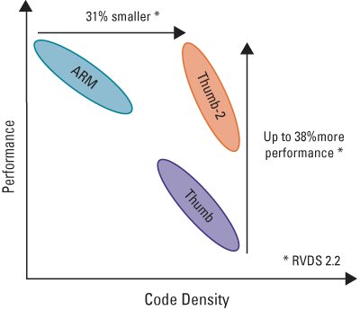
Architecture Extensions
Improved Code Density
Improved Performance
Power Efficiency

Slide 18
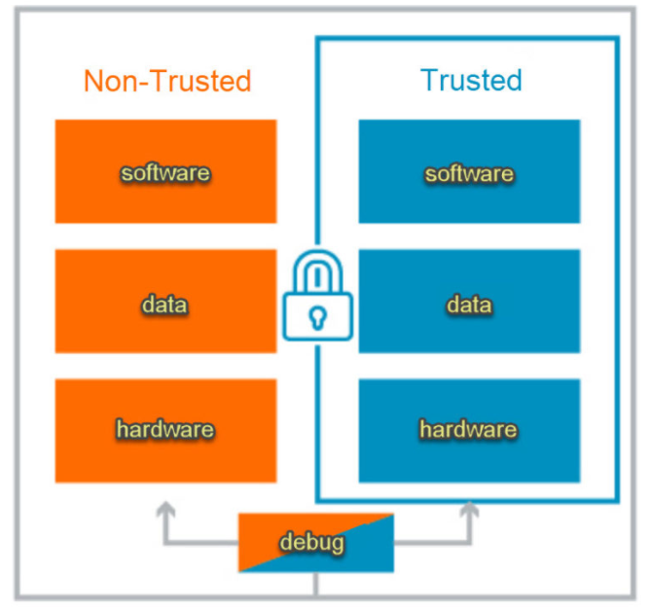

Architecture Extensions…
The TrustZone®
Provide a Trusted Execution Environment (TEE)
Consistent programming model across platforms and applications
Hardware backed security environment

Slide 19
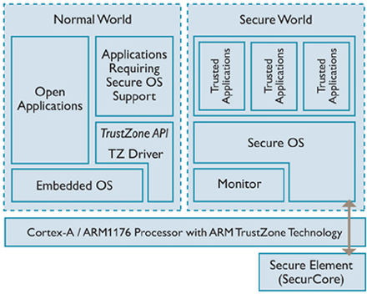
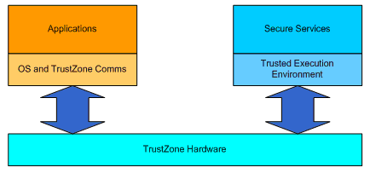
Trust zone – s/w

Slide 20

Architecture Extensions…
Jazelle®
Technology to enable Jazelle H/w in any existing JVM
Full featured multi-tasking Java Virtual Machine JVM
Enables acceleration of execution environments

Slide 21
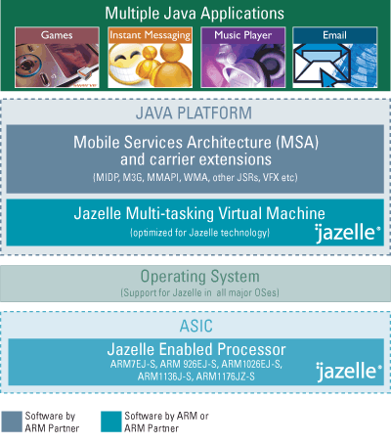
Jazelle
JDBX
Java Direct Byte-code
Execution
JRCT
Java Runtime
compilation Tool suite

Slide 22
Apple iPhone Key Design Win for NXP ARM
LPC2211
PMU
12 Logic Parts
5$ – 6 $ content
2007
2008
4 - 5 Mega Units
10 Mega Units

Slide 23

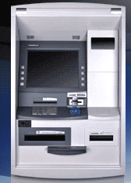
Significant Design-Win Americas: Q4 2006
Significance | Used LPC900 MCUs to beat Microchip on high volume consumer product | Automation Bank machine can be chosen as world platform by Diebold. Provides stronger security system in this kind of product.
Customer | Diebold - Procomp
MMS DW Product | LPC2144FBD64-S
Other NXP/MMS part types
End Product | Automation Bank Machine
Application | Baking
Quantity (EAU) | 50k units
Value (3yr/5yr auto) | $1.00 mil (3yr)
NXP Competitive Advantage | NXP MCU is most competitive package product solution |  | Sales Engineer | Marcelo Gonçalves

Slide 24

ARM Partnership Model
Notes:
ARM’s business model centres around the principle of partnership. At the centre of this are ARM’s semiconductor partners who design, manufacture and market ARM-compliant products.
Having so many partner companies producing silicon executing the same instruction set is a very important part of ARM’s strength in the market place.
However each of our semiconductor partners bring their own unique strengths to the partnership - each having their own technologies, applications knowledge, product focus, culture, geography, and key customers.
In addition to our partnering with semiconductor companies, we also partner with a large number of other third parties to ensure that operating systems, EDA and software development tools, application software and design services are available for doing ARM based designs.
“ATAP” stands for ARM Technology Access Program. Creates a network of independent design service companies and equips them to deliver ARM-powered designs. Members get access to ARM technology, expertise and support. Members sometimes referred to as “Approved Design Centers”.

Slide 25

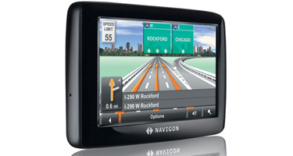
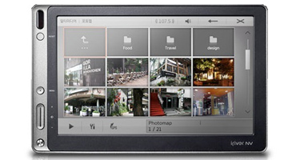
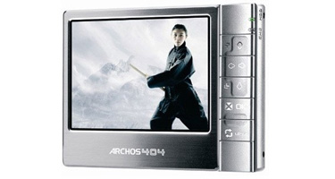

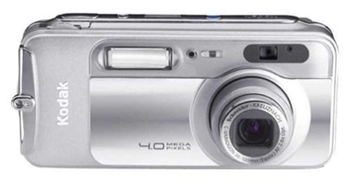
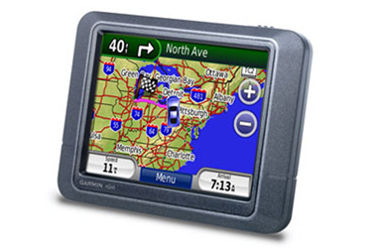


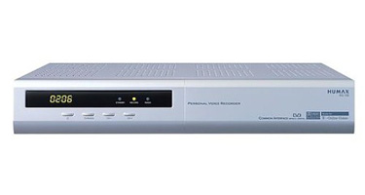
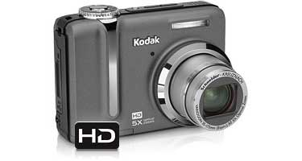

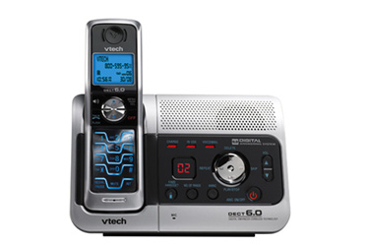

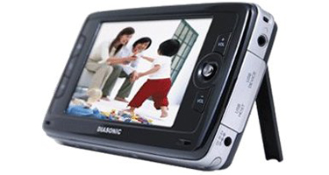
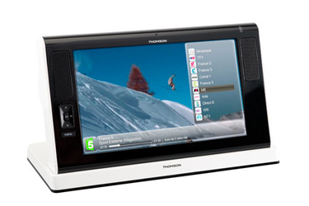
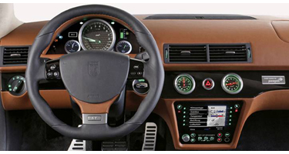

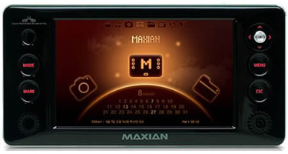
End Products

Slide 26
Agenda
ARM Introduction
Architecture Extensions
ARM7TDMI-S
Processor Modes
Registers
ARM Vs Thumb
Instruction Set
System Design
Summary

Slide 27
ARM7 TDMI - S
The ARM7TDMI-S is based on ARM7 Core
3 Stage Pipeline
Von-Neumann Architecture
CPI ~ 1.9
T – Thumb instruction Sets
D – includes debug extensions
M – Enhanced Multipliers
I – Core has Embedded ICE logic extensions
S – Fully Synthesizable soft IP

Slide 28
ARM7 Family
ARM7 Family Includes…
ARM7TDMI
ARM7TDMI-S (ARM v4T)
ARM720T
ARM7EJ-S
T - Thumb® instruction set
T - Thumb® instruction set
T – Thumb
D - Debug extension
M-Enhanced multiplier (32x8)
I-Embedded ICE
D - Debug extension
M-Enhanced multiplier (32x8)
I-Embedded ICE
S – Synthesizable Macro
E – DSP Extension
J – Jazelle®, Java Extension
S – Synthesizable
MMU Included
Uses ARM7TDMI-S CPU

Slide 29
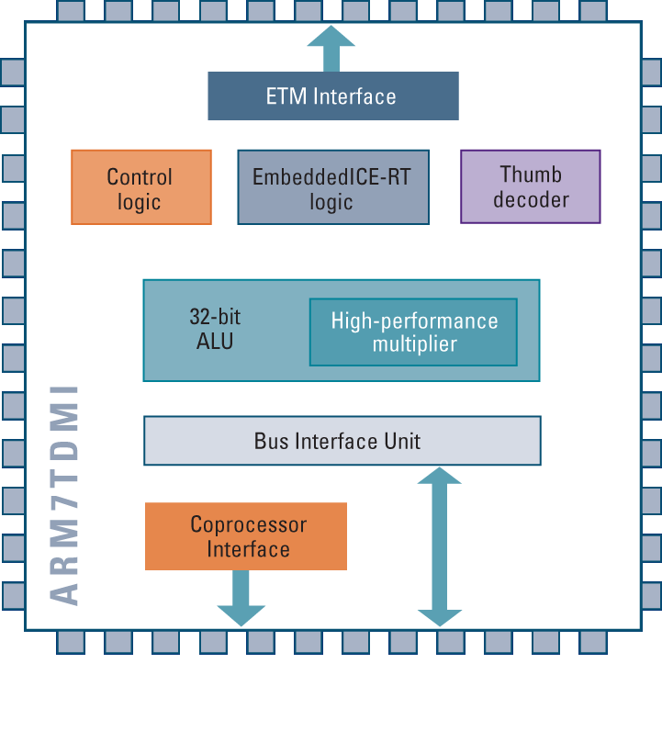
Bus Width
ARM7 is a 32-bit architecture
Data Paths and Instructions (ARM) are 32 bits wide
Von-Neumann Architecture
Instructions and Data use same bus
Thumb Mode
Subset of 16-bit instructions
Code density optimization

Slide 30
Thumb State
Set of instructions re-coded into 16 bits
Improved code density by ~ 30%
saving program memory space
In Thumb state only the program code is 16-bit wide
after fetching the 16-bit instructions from memory, they are de-compressed to 32 bit instructions before they are decoded and executed
all operations are still 32-bit operations

Slide 31
Data Types and Alignment
Definitions (Little endian or big endian are options):
Word = 32 bits (four bytes)
Halfword = 16 bits (two bytes)
Byte = 8 bits
1
2
3
4
1
2
3
4
Word
Word
Halfword
Halfword
Halfword
Halfword
Byte
Byte
Byte
Byte
Byte
Byte
Byte
Byte
Halfword
Halfword
Word
Word

Slide 32
Data and Instruction
DATA when used in ARM
Byte : 8 bits
Half Word : 16 bits (2 Bytes)
Word : 32 bits (4 Bytes)
Instruction Set of most ARMs
32 bits ARM Instruction Set
16 bits Thumb Instruction Set

Slide 33
Agenda
ARM Introduction
Architecture Extensions
ARM7TDMI-S
Processor Modes
Registers
ARM Vs Thumb
Instruction Set
System Design
Summary

Slide 34
Processor Modes
User
Unprivileged Mode
Most tasks run on this mode
FIQ
Entered when a high priority Interrupt is occurred
IRQ
Entered when a low priority interrupt (normal) is occurred
Supervisory
Entered on Reset
Entered on Software Interrupt
Abort
To handle memory access violations
Undefined
To handle un-defined instructions
System
Privileged mode using the same registers as user mode

Slide 35
Agenda
ARM Introduction
Architecture Extensions
ARM7TDMI-S
Processor Modes
Registers
ARM Vs Thumb
Instruction Set
System Design
Summary

Slide 36
The Registers
ARM has 37 registers all of which are 32 bits long
1 dedicated Program Counter
1 dedicated Current Program Status Register (CPSR)
5 dedicated Saved Program Status Register (SPSR)
30 General Purpose Register
The current processor mode governs the access of register banks
A particular set of r0-r12 registers
A particular r13 (stack pointer) and r14 (link register, LR)
The program counter (PC)
The current program status register (CPSR)
Privileged Mode can access
A particular SPSR (Saved Program Status Register)
Notes:
The ARM architecture provides a total of 37 registers, all of which are 32-bits long. However these are arranged into several banks, with the accessible bank being governed by the current processor mode. We will see this in more detail in a couple of slides. In summary though, in each mode, the core can access:
a particular set of 13 general purpose registers (r0 - r12).
a particular r13 - which is typically used as a stack pointer. This will be a different r13 for each mode, so allowing each exception type to have its own stack.
a particular r14 - which is used as a link (or return address) register. Again this will be a different r14 for each mode.
r15 - whose only use is as the Program counter.
The CPSR (Current Program Status Register) - this stores additional information about the state of the processor:
And finally in privileged modes, a particular SPSR (Saved Program Status Register). This stores a copy of the previous CPSR value when an exception occurs. This combined with the link register allows exceptions to return without corrupting processor state.

Slide 37
The ARM Register Set
Current Visible Registers
Current Visible Registers
Current Visible Registers
Current Visible Registers
Current Visible Registers
Current Visible Registers
r0
r0
r0
r0
r0
r0
Abort Mode
r0
SVC Mode
Undef Mode
FIQ Mode
User Mode
IRQ Mode
r1
r1
r1
r1
r1
r1
r1
r2
r2
r2
r2
r2
r2
r2
Banked out Registers
Banked out Registers
Banked out Registers
Banked out Registers
Banked out Registers
r3
Banked out Registers
r3
r3
r3
r3
r3
r3
r4
r4
r4
r4
r4
r4
r4
r5
r5
r5
r5
r5
r5
r5
User
User
User
User
FIQ
FIQ
FIQ
FIQ
FIQ
IRQ
IRQ
IRQ
IRQ
IRQ
SVC
SVC
SVC
SVC
SVC
Undef
Undef
Undef
Undef
Undef
Abort
Abort
Abort
Abort
Abort
r6
User
FIQ
IRQ
SVC
Undef
Abort
r6
r6
r6
r6
r6
r6
r7
r7
r7
r7
r7
r7
r7
r8
r8
r8
r8
r8
r8
r8
r8
r8
r8
r8
r8
r8
r8
r9
r9
r9
r9
r9
r9
r9
r9
r9
r9
r9
r9
r9
r9
r10
r10
r10
r10
r10
r10
r10
r10
r10
r10
r10
r10
r10
r10
r11
r11
r11
r11
r11
r11
r11
r11
r11
r11
r11
r11
r11
r11
r12
r12
r12
r12
r12
r12
r12
r12
r12
r12
r12
r12
r12
r12
r13 (sp)
r13 (sp)
r13 (sp)
r13 (sp)
r13 (sp)
r13 (sp)
r13 (sp)
r13 (sp)
r13 (sp)
r13 (sp)
r13 (sp)
r13 (sp)
r13 (sp)
r13 (sp)
r13 (sp)
r13 (sp)
r13 (sp)
r13 (sp)
r13 (sp)
r13 (sp)
r13 (sp)
r13 (sp)
r13 (sp)
r13 (sp)
r13 (sp)
r13 (sp)
r13 (sp)
r13 (sp)
r13 (sp)
r13 (sp)
r13 (sp)
r13 (sp)
r13 (sp)
r13 (sp)
r13 (sp)
r13 (sp)
r13 (sp)
r13 (sp)
r13 (sp)
r13 (sp)
r13 (sp)
r13 (sp)
r14 (lr)
r14 (lr)
r14 (lr)
r14 (lr)
r14 (lr)
r14 (lr)
r14 (lr)
r14 (lr)
r14 (lr)
r14 (lr)
r14 (lr)
r14 (lr)
r14 (lr)
r14 (lr)
r14 (lr)
r14 (lr)
r14 (lr)
r14 (lr)
r14 (lr)
r14 (lr)
r14 (lr)
r14 (lr)
r14 (lr)
r14 (lr)
r14 (lr)
r14 (lr)
r14 (lr)
r14 (lr)
r14 (lr)
r14 (lr)
r14 (lr)
r14 (lr)
r14 (lr)
r14 (lr)
r14 (lr)
r14 (lr)
r14 (lr)
r14 (lr)
r14 (lr)
r14 (lr)
r14 (lr)
r14 (lr)
r15 (pc)
r15 (pc)
r15 (pc)
r15 (pc)
r15 (pc)
r15 (pc)
r15 (pc)
cpsr
cpsr
cpsr
cpsr
cpsr
cpsr
cpsr
spsr
spsr
spsr
spsr
spsr
spsr
spsr
spsr
spsr
spsr
spsr
spsr
spsr
spsr
spsr
spsr
spsr
spsr
spsr
spsr
spsr
spsr
spsr
spsr
spsr
spsr
spsr
spsr
spsr
spsr
spsr
spsr
spsr
spsr
spsr
Notes:
This animated slide shows the way that the banking of registers works. On the left the currently visible set of registers are shown for a particular mode.
On the right are the registers that are banked out whilst in that mode.
Each key press will switch mode:
user -> FIQ ->user -> IRQ -> user ->SVC -> User -> Undef -> User -> Abort and then back to user.
The following slide then shows this in a more static way that is more useful for reference

Slide 38
Register Organization Summary
User
FIQ
IRQ
SVC
Undef
Abort
r0
User mode r0-r7, r15, and cpsr
User mode r0-r12, r15, and cpsr
User mode r0-r12, r15, and cpsr
User mode r0-r12, r15, and cpsr
User mode r0-r12, r15, and cpsr
r1
r2
r3
r4
r5
Thumb state
Low registers
r6
r7
r8
r8
r9
r9
r10
r10
Thumb state
High registers
r11
r11
r12
r12
r13 (sp)
r13 (sp)
r13 (sp)
r13 (sp)
r13 (sp)
r13 (sp)
r14 (lr)
r14 (lr)
r14 (lr)
r14 (lr)
r14 (lr)
r14 (lr)
r15 (pc)
cpsr
spsr
spsr
spsr
spsr
spsr
Note: System mode uses the User mode register set
Notes:
This slide shows the registers visible in each mode - basically in a more static fashion than the previous animated slide that is more useful for reference.
The main point to state here is the splitting of the registers in Thumb state into Low and High registers.
ARM register banking is the minimum necessary for fast handling of overlapping exceptions of different types (e.g. ABORT during SWI during IRQ). For nested exceptions of the same type (e.g. re-entrant interrupts) some additional pushing of registers to the stack is required.

Slide 39
Program Status Registers
31
28
27
24
23
16
15
8
7
6
5
4
0
N Z C V Q
U n d e f i n e d
I F T mode
J
f
s
x
c
Condition code flags
N = Negative result from ALU
Z = Zero result from ALU
C = ALU operation Carried out
V = ALU operation overflowed
Sticky Overflow flag - Q flag
Architecture 5TE/J only
Indicates if saturation has occurred
J bit
Architecture 5TEJ only
J = 1: Processor in Jazelle state
Interrupt Disable bits.
I = 1: Disables the IRQ.
F = 1: Disables the FIQ.
T Bit
Architecture xT only
T = 0: Processor in ARM state
T = 1: Processor in Thumb state
Mode bits
Specify the processor mode
Notes:
Green psr bits are only in certain versions of the ARM architecture
ALU status flags (set if "S" bit set, implied in Thumb state).
Sticky overflow flag (Q flag) is set either when
saturation occurs during QADD, QDADD, QSUB or QDSUB, or
the result of SMLAxy or SMLAWx overflows 32-bits
Once flag has been set can not be modified by one of the above instructions and must write to CPSR using MSR instruction to cleared
PSRs split into four 8-bit fields that can be individually written:
Control (c) bits 0-7
Extension (x) bits 8-15 Reserved for future use
Status (s) bits 16-23 Reserved for future use
Flags (f) bits 24-31
Bits that are reserved for future use should not be modified by current software. Typically, a read-modify-write strategy should be used to update the value of a status register to ensure future compatibility. Note that the T/J bits in the CPSR should never be changed directly by writing to the PSR (use the BX/BXJ instruction to change state instead).
However, in cases where the processor state is known in advance (e.g. on reset, following an interrupt, or some other exception), an immediate value may be written directly into the status registers, to change only specific bits (e.g. to change mode).
New ARM V6 bits now shown.

Slide 40
Exception Handling
When an exception occurs, the ARM:
Copies CPSR into SPSR_<mode>
Sets appropriate CPSR bits
Change to ARM state
Change to exception mode
Disable interrupts (if appropriate)
Stores the return address in LR_<mode>
Sets PC to vector address
To return, exception handler needs to:
Restore CPSR from SPSR_<mode>
Restore PC from LR_<mode>
This can only be done in ARM state.
0x1C
FIQ
0x18
IRQ
0x14
(Reserved)
0x10
Data Abort
0x0C
Prefetch Abort
0x08
Software Interrupt
0x04
Undefined Instruction
0x00
Reset
Vector Table
Vector table can be at 0xFFFF0000 on ARM720T and on ARM9/10 family devices
Notes:
Exception handling on the ARM is controlled through the use of an area of memory called the vector table. This lives (normally) at the bottom of the memory map from 0x0 to 0x1c. Within this table one word is allocated to each of the various exception types.
This word will contain some form of ARM instruction that should perform a branch. It does not contain an address.
Reset - executed on power on
Undef - when an invalid instruction reaches the execute stage of the pipeline
SWI - when a software interrupt instruction is executed
Prefetch - when an instruction is fetched from memory that is invalid for some reason, if it reaches the execute stage then this exception is taken
Data - if a load/store instruction tries to access an invalid memory location, then this exception is taken
IRQ - normal interrupt
FIQ - fast interrupt
When one of these exceptions is taken, the ARM goes through a low-overhead sequence of actions in order to invoke the appropriate exception handler. The current instruction is always allowed to complete (except in case of Reset).
IRQ is disabled on entry to all exceptions; FIQ is also disabled on entry to Reset and FIQ.

Slide 41
Agenda
ARM Introduction
Architecture Extensions
ARM7TDMI-S
Processor Modes
Registers
ARM Vs Thumb
Instruction Set
System Design
Summary

Slide 42
Thumb vs. ARM
r0
r0
r1
r1
r2
r2
Thumb state
Low registers
r3
r3
r4
r4
r5
r5
r6
r6
r7
r7
Thumb
State
ARM
State
r8
r9
r10
Thumb state
High registers
r11
r12
r13 (SP)
r13 (SP)
r14 (LR)
r14 (LR)
r15 (PC)
r15 (PC)
CPSR
CPSR
SPSR
SPSR

Slide 43
Registers in Thumb State
The Thumb state register set is a subset of the ARM state set. The programmer has direct access to:
eight general registers r0 - r7
the program counter PC
a Stack pointer SP
a Link register LR
the current program status register CPSR
In Thumb state, the high registers (r8 - r12) are not part of the standard register set. The assembly language programmer has limited access to them, but can use them for fast temporary storage

Slide 44
Program Counter (r15)
When the processor is executing in ARM state:
All instructions are 32 bits wide
All instructions must be word aligned
Therefore the pc value is stored in bits [31:2] with bits [1:0] undefined (as instruction cannot be halfword or byte aligned).
When the processor is executing in Thumb state:
All instructions are 16 bits wide
All instructions must be halfword aligned
Therefore the pc value is stored in bits [31:1] with bit [0] undefined (as instruction cannot be byte aligned).
When the processor is executing in Jazelle state:
All instructions are 8 bits wide
Processor performs a word access to read 4 instructions at once
Notes:
ARM is designed to efficiently access memory using a single memory access cycle. So word accesses must be on a word address boundary, halfword accesses must be on a halfword address boundary. This includes instruction fetches.
Point out that strictly, the bottom bits of the PC simply do not exist within the ARM core - hence they are ‘undefined’. Memory system must ignore these for instruction fetches.
In Jazelle state, the processor doesn’t perform 8-bit fetches from memory. Instead it does aligned 32-bit fetches (4-byte prefetching) which is more efficient. Note we don’t mention the PC in Jazelle state because the ‘Jazelle PC’ is actually stored in r14 - this is technical detail that is not relevant as it is completely hidden by the Jazelle support code.

Slide 45
Agenda
ARM Introduction
Architecture Extensions
ARM7TDMI-S
Processor Modes
Registers
ARM Vs Thumb
Instruction Set
System Design
Summary

Slide 46

Instruction Set
All instructions are 32-bits long
Many instructions execute in a single cycle
Instructions are conditionally executed
ARM is a load / store architecture
via registers => RISC
Load or store multiple registers in a single instruction
using <register list>

Slide 47
Conditional Execution
Mnemonic | Description
EQ | Equal
NE | Not equal
CS / HS | Carry Set / Unsigned higher or same
CC / LO | Carry Clear / Unsigned lower
MI | Negative
PL | Positive or zero
VS | Overflow
VC | No overflow
HI | Unsigned higher
LS | Unsigned lower or same
GE | Signed greater than or equal
LT | Signed less than
GT | Signed greater than
LE | Signed less than or equal
AL | Always (normally omitted)

Slide 48
Thumb Instruction Set (1)
Instruction Types
Branch
Unconditional ± 2KBytes
Conditional ± 256Bytes
Branch with Link ± 4MBytes (2 Instructions!)
Branch and exchange change to ARM state if Rm[0] = 0
Branch and exchange with Link
Data Processing
Subset of ARM data processing instructions
Not conditionally executed (but some update flags)

Slide 49
ARM and Thumb Interworking
Switch between ARM state and Thumb state using BX instruction
In ARM state: BX<condition> Rn
In Thumb state: BX Rn
Rn
n: 0-15
31
1
0
ARM / Thumb selection
0: ARM state
1: Thumb state
BX
31
1
0
Destination
address
0
Notes:
The BX (Branch and Exchange) instruction branches to an address held in a register Rm, with an optional switch to Thumb execution. The branch target address is the value of register Rm, with its bit[0] forced to zero. The instruction set to be used at the branch target is chosen by setting the CPSR T bit to bit[0] of Rm.

Slide 50
Instruction Pipeline
The ARM7TDMI-S core uses a pipeline
Increase the speed of the flow of instructions
Enables several operations to take place simultaneously
Program Counter (PC) points to instruction being fetched rather than that being executed
During normal pipelined operation
An instruction x is executed
Instruction (x-1) is being decoded
Instructino (x-2) is being fetched

Slide 51
3-Stage Instruction Pipeline
ARM
PC
PC - 4
PC - 8
Thumb
PC
PC - 2
PC - 4
Fetch
Instruction Fetched from Memory
Thumb only: Thumb instruction decompressed to ARM instruction Instruction decoded
Registers read from Register Bank, Shift and ALU operations performed, Registers written back to Register Bank
Decode
Execute

Slide 52
Optimal Pipelining
In this example it takes 6 clock cycles to execute 6 instructions
All operations are on registers (single cycle instructions)
Clock cycles per instruction (CPI) = 1
ADD
Fetch
Decode
Execute
SUB
Fetch
Decode
Execute
MOV
Fetch
Decode
Execute
AND
Fetch
Decode
Execute
ORR
Fetch
Decode
Execute
EOR
Fetch
Decode
Execute
CMP
Fetch
Decode
RSB
Fetch
1
2
3
4
5
6
7
8
Cycle

Slide 53
Branch Pipeline Example
Branches break the pipeline
Example in ARM state
BL
0x8000
Fetch
Decode
Execute
Linkret
Adjust
X
0x8004
Fetch
Decode
X
0x8008
Fetch
ADD
0x8FEC
Fetch
Decode
Execute
SUB
0x8FF0
Fetch
Decode
Execute
MOV
0x8FF4
Fetch
Decode
AND
0x8FF8
Fetch
1
2
3
4
5
6
7
Cycle

Slide 54
Agenda
ARM Introduction
Architecture Extensions
ARM7TDMI-S
Processor Modes
Registers
ARM Vs Thumb
Instruction Set
System Design
Summary

Slide 55
Example ARM based System
RAM
16 bit wide
ARM core
Interrupt Controller
Peripherals
I / O
ROM
8 bit wide
RAM
32 bit wide

Slide 56

Advanced Microcontroller Bus Architecture
on-chip interconnect
established, open specification
framework for SoC designs
enabler for IP reuse
‘digital glue’ that binds IP cores together

Slide 57
Example AMBA System
ARM core
Keypad
UART
High-bandwidth Memory Interface
AHB
APB Bridge
APB
Timer
Display
RTC
High-bandwidth on-chip RAM
DMA Bus Master
I/O

Slide 58
AHB and APB / VPB
Advanced High-Performance Bus
high-performance
pipelined
fully-synchronous backplane
multiple bus masters
Advanced Peripheral Bus / VLSI Peripheral Bus
low-power
non-pipelined
simple interface
wait support (VPB)

Slide 59
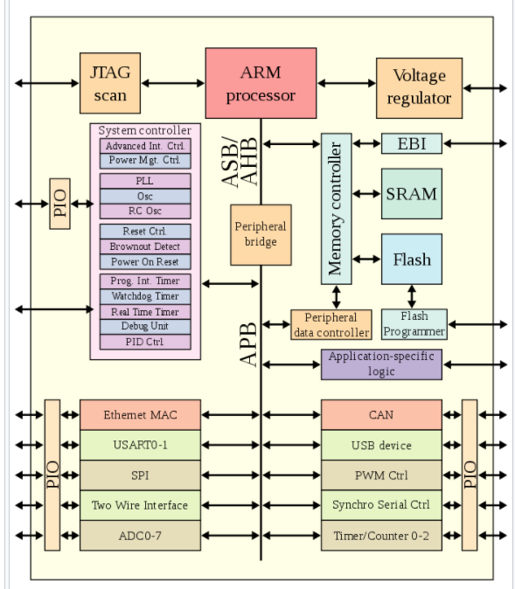
ARM

Slide 60

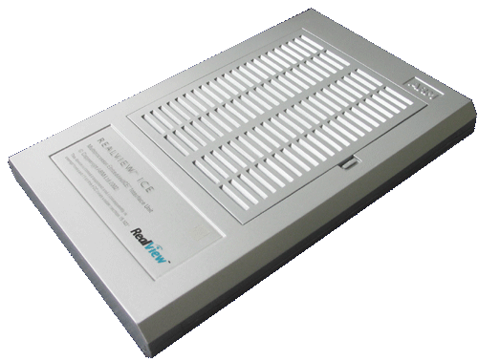
ARM Debug Architecture
Ethernet
Debugger (+ optional
trace tools)
EmbeddedICE Logic
Provides breakpoints and processor/system access
JTAG interface (ICE)
Converts debugger commands to JTAG signals
Embedded trace Macrocell (ETM)
Compresses real-time instruction and data access trace
Contains ICE features (trigger & filter logic)
Trace port analyzer (TPA)
Captures trace in a deep buffer
JTAG port
Trace Port
ARM
core
ETM
TAP
controller
EmbeddedICE
Logic
Notes:
Debugger trace tools
Have copy of the code image
Configure ETM trace via JTAG
Receive compressed trace from ETM
Decompress ETM trace using code image

Slide 61
Why ARM?
ARM7 is an open architecture
Already the preferred 32-bit solution in Automotive, Communication and Industrial markets.
Same tools for all ARM7 of different manufacturer. Often the same tools can be used for ARM9/10/11. Customers can save money
ARM is a scalable and uniform architecture. ARM7 is binary code compatible with ARM9/10. customer can chose the right product for its target application saving time due to the reduced learning curve.

Slide 62
References
www.arm.com
http://www.arm.com/markets/
http://in.youtube.com/watch?v=4VRtujwa_b8
ARM Webinars | ARM Video Search
http://infocenter.arm.com/help/index.jsp?topic=/com.arm.doc.set.appnotes/

Slide 63
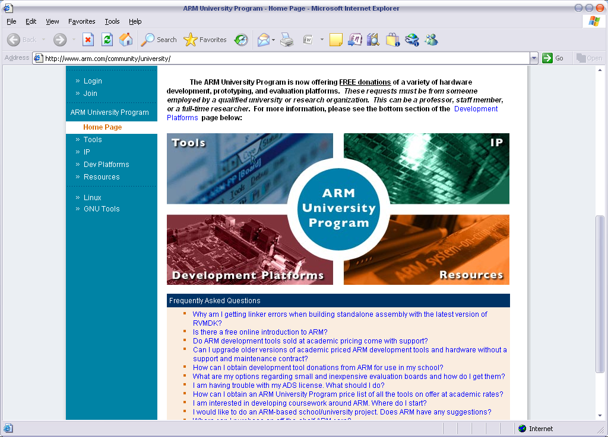
References

Slide 64
Summary
ARM Company Overview | Introduction
Various Architecture Extensions
Different Processor Modes
Internal Registers Usages
ARM Vs Thumb
Instruction Set

Slide 65


Questions ?

Slide 66

Thank You!

